Slide 1

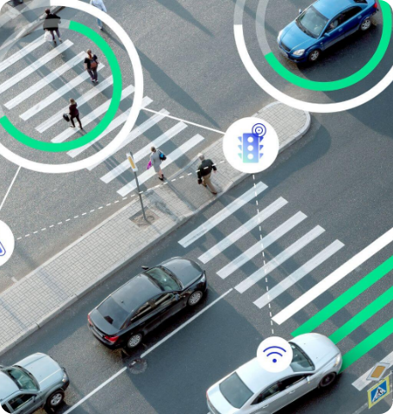



Design & Simulation of an Intelligent Traffic Signal System
Implementing Decision Logic using Pure Combinational Circuits
PROJECT TEAM MEMBERS
2620030100
B. Revanth Kumar
2620030090
P. Rohan
2620080077
Jaya Haasika
2620030046
Eshha
2620030407
Chaitanya
DEPARTMENT OF COMPUTER SCIENCE & ENGINEERING
1st Year / 1st Semester Academic Evaluation
Digital Design & Computer Architecture (DDCA)
Slide 1 of 9

Slide 2







Introduction & Motivation
Urban Traffic Challenge
Conventional traffic signals rely on fixed-time delays regardless of real-time road occupancy. This creates unnecessary waiting times at empty roads and severe bottlenecks on heavily congested lanes.
An intelligent system dynamically evaluates vehicle presence using road sensors and provides real-time signal decision making.
Core Objective: "The system automatically adjusts signal decisions in real-time according to instantaneous traffic conditions using digital logic."
Fixed Timer Control
Decision-Based Control
Ignores actual vehicle presence; causes high idle delay and wasted throughput.
Uses combinational boolean logic to immediate trigger green signals for active lanes.
Digital Design & Computer Architecture (DDCA)
Slide 2 of 9

Slide 3







Problem Statement & Objectives
1. Sensor Mapping
2. Logic Modeling
Problem Statement
Represent traffic presence on intersecting roads using binary logic variables (A, B).
Construct truth tables mapping all possible traffic input combinations to signal outputs.
To design and simulate a fundamental digital traffic signal decision system that takes binary inputs from road vehicle sensors and yields optimized green/red output decisions through logic gates.
3. Boolean Expressions
4. Gate Simulation
Focus: Demonstrating foundational 1st-year DDCA concepts using pure combinational logic design techniques.
Derive simplified algebraic equations ($G_A, G_B$) for optimal decision rules.
Implement and verify logic circuits using standardized simulation tools (e.g., Logisim).
Digital Design & Computer Architecture (DDCA)
Slide 3 of 9

Slide 4




System Architecture
High-level block diagram showing signal processing flow from physical road detection inputs to final light indicators:
Traffic Sensors
Input Encoding
Decision Circuit
Signal Outputs
Vehicle Detectors
Road A (A), Road B (B)
Clean binary conversion
(0 = Clear, 1 = Traffic)
Combinational Logic
(AND, NOT Gates)
Road A Green ($G_A$)
Road B Green ($G_B$)
Combinational Design Note
Practical Scope Boundary
The system operates entirely as a memoryless decision circuit. Outputs react instantly to input changes without internal state storage or feedback loops.
Demonstrates the decision stage. Full deployment in real infrastructure requires secondary timer sequencing and interlocking relays for safety.
Digital Design & Computer Architecture (DDCA)
Slide 4 of 9

Slide 5



Combinational Logic Design
Core Working Principle
Safety & Conflict Rules
A combinational logic circuit is a digital circuit whose output at any instant is determined solely by the current combination of inputs.
Mutual Exclusion: Both intersecting roads must never receive a green signal simultaneously ($G_A \cdot G_B = 0$).
Default Safety Red: If both roads report vehicle traffic simultaneously ($A=1, B=1$), the basic decision model defaults signals to RED to prevent collision.
Emergency Priority ($E$): Can be integrated via OR-override gates to force green for priority vehicles.
Sample Decision Rule
Road A receives a Green signal decision ($G_A=1$) if and only if traffic is detected on Road A ($A=1$) AND no traffic is detected on Road B ($B=0$).
Digital Design & Computer Architecture (DDCA)
Slide 5 of 9

Slide 6



Truth Table & Expressions
Truth Table for Two-Road Intersection Decision Logic ($A, B$ Inputs vs $G_A, G_B$ Outputs):
Boolean Expressions
A (Road A) | B (Road B) | GA (Green A) | GB (Green B) | System Action / State
0 | 0 | 0 | 0 | No traffic (Both Red)
0 | 1 | 0 | 1 | Traffic on B (Green B)
1 | 0 | 1 | 0 | Traffic on A (Green A)
1 | 1 | 0 | 0 | Conflict (Safety Red)
Road A Signal Equation:
Road B Signal Equation:
Insight:
Digital Design & Computer Architecture (DDCA)
Slide 6 of 9

Slide 7





Circuit & Simulation
Step 1: Input Toggle Binary Sensor Signals ($A, B$)
Step 2: Signal Inversion NOT Gates ($\neg A, \neg B$)
Step 3: Logic Decision 2-Input AND Gates
Step 4: Output Display Green / Red Light LEDs
Simulation Environment
INPUT A = 1
GA = 1 (GREEN)
The circuit design can be simulated and verified using standard schematic software:
Logisim / Logisim Evolution (Educational schematic tool)
INPUT B = 0
GB = 0 (RED)
Proteus PCB & VSM (Hardware simulation)
Digital by HNeemann (Fast digital logic simulator)
Digital Design & Computer Architecture (DDCA)
Slide 7 of 9

Slide 8






Results & Key Advantages
Verification Matrix
Test Case 2
Test Case 3
A=1, B=0 → $G_A=1$
A=0, B=1 → $G_B=1$
Zero Processing Latency
Low Implementation Cost
High Reliability
Educational Value
Instant gate propagation response without software execution lag.
Requires minimal hardware components (Standard 74xx IC gates).
Immune to software crashes, operating system freezes, or memory leaks.
Ideal baseline model for understanding foundational digital logic concepts.
Digital Design & Computer Architecture (DDCA)
Slide 8 of 9

Slide 9


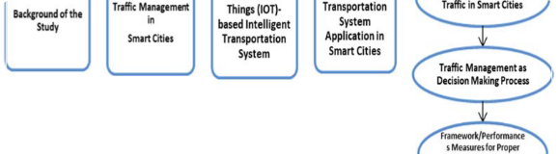



Conclusion & Future Scope
Project Conclusion
This project successfully demonstrates how combinational logic design principles can be applied to build an intelligent, responsive traffic signal decision system. Binary Boolean expressions accurately model real-world road priorities and verify seamlessly in software simulation.
Future Scope & Enhancements:
Thank You! Questions & Discussion Welcome.
Digital Design & Computer Architecture (DDCA)
Slide 9 of 9

Slide 10
